Slide 1





Measuring Social Uncertainty Judgment Through Early Development
An NIH F99/K00 Proposal

Slide 2
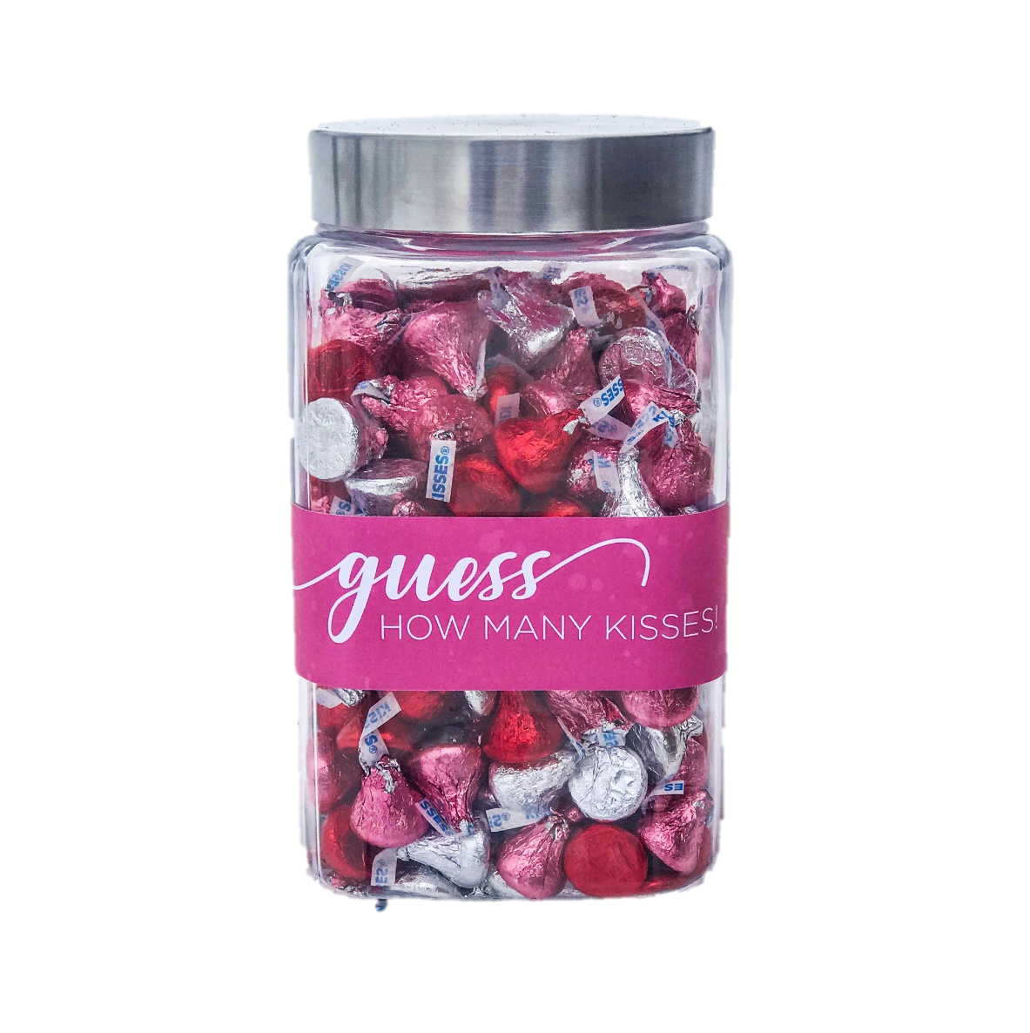
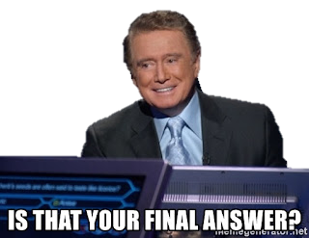
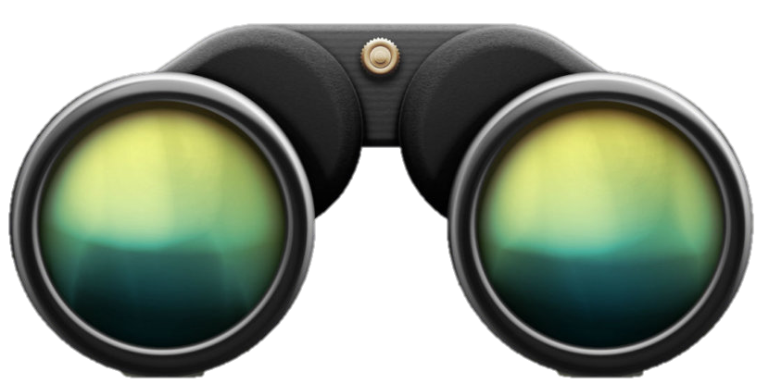
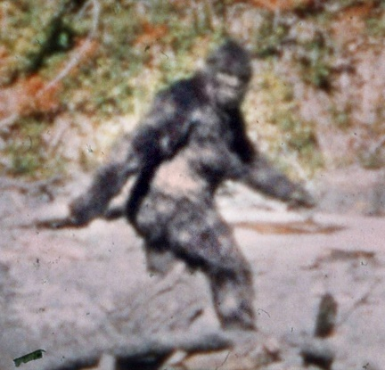
Notes:
Perceptions And we can measure how people form judgments of certainty in these domains

Slide 3

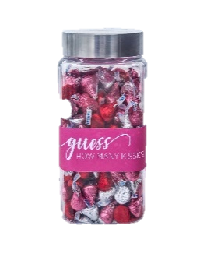
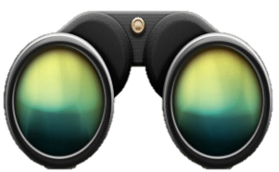

Notes:
However, when we’re trying to read the faces of our new classmates

Slide 4
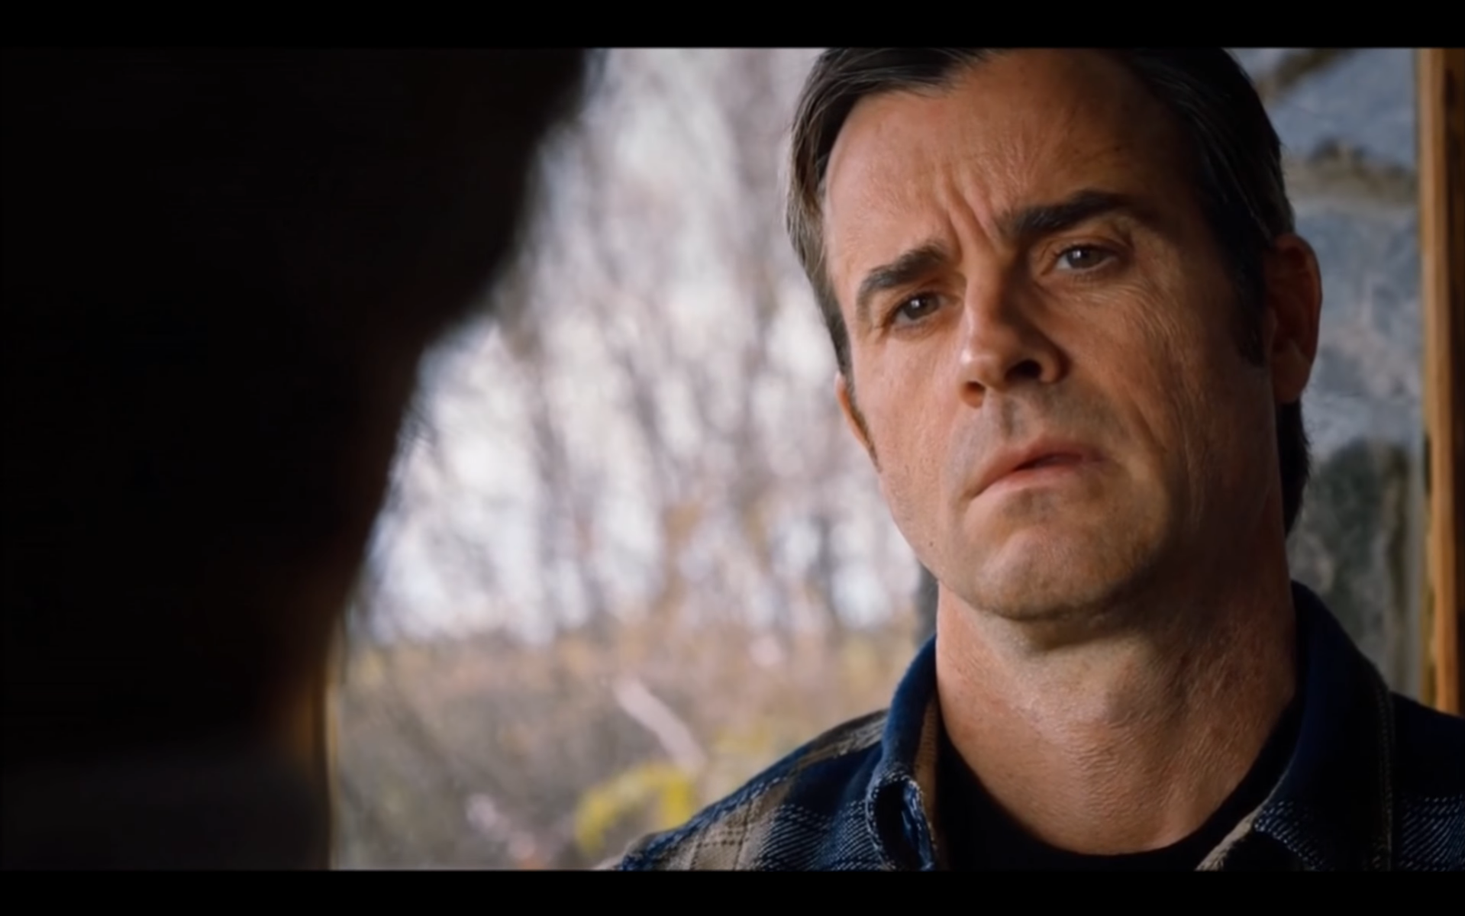
Notes:
Or figure out if the story we’re being told is a lie

Slide 5
Non-Social Uncertainty
Social Uncertainty
Notes:
Or figure out if the story we’re being told is a lie

Slide 6
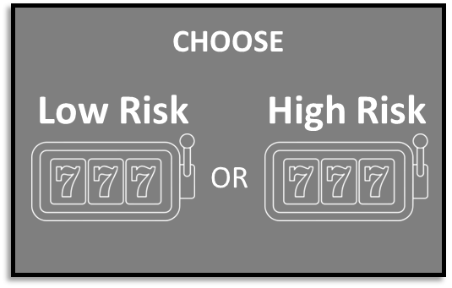

+
Risk
+
CHOOSE
Low Risk
High Risk
OR
Notes:
With well established trial by trial paradigms wherein participants make choices among known

Slide 7
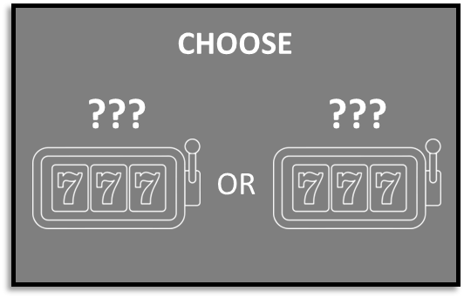
+
Risk
+
CHOOSE
Low Risk
High Risk
+
OR
Ambiguity
+
CHOOSE
???
???
OR
Notes:
Or unknown outcome probabilities, often in the context of economic gains or losses

Slide 8


Notes:
Or figure out if the story we’re being told is a lie

Slide 9

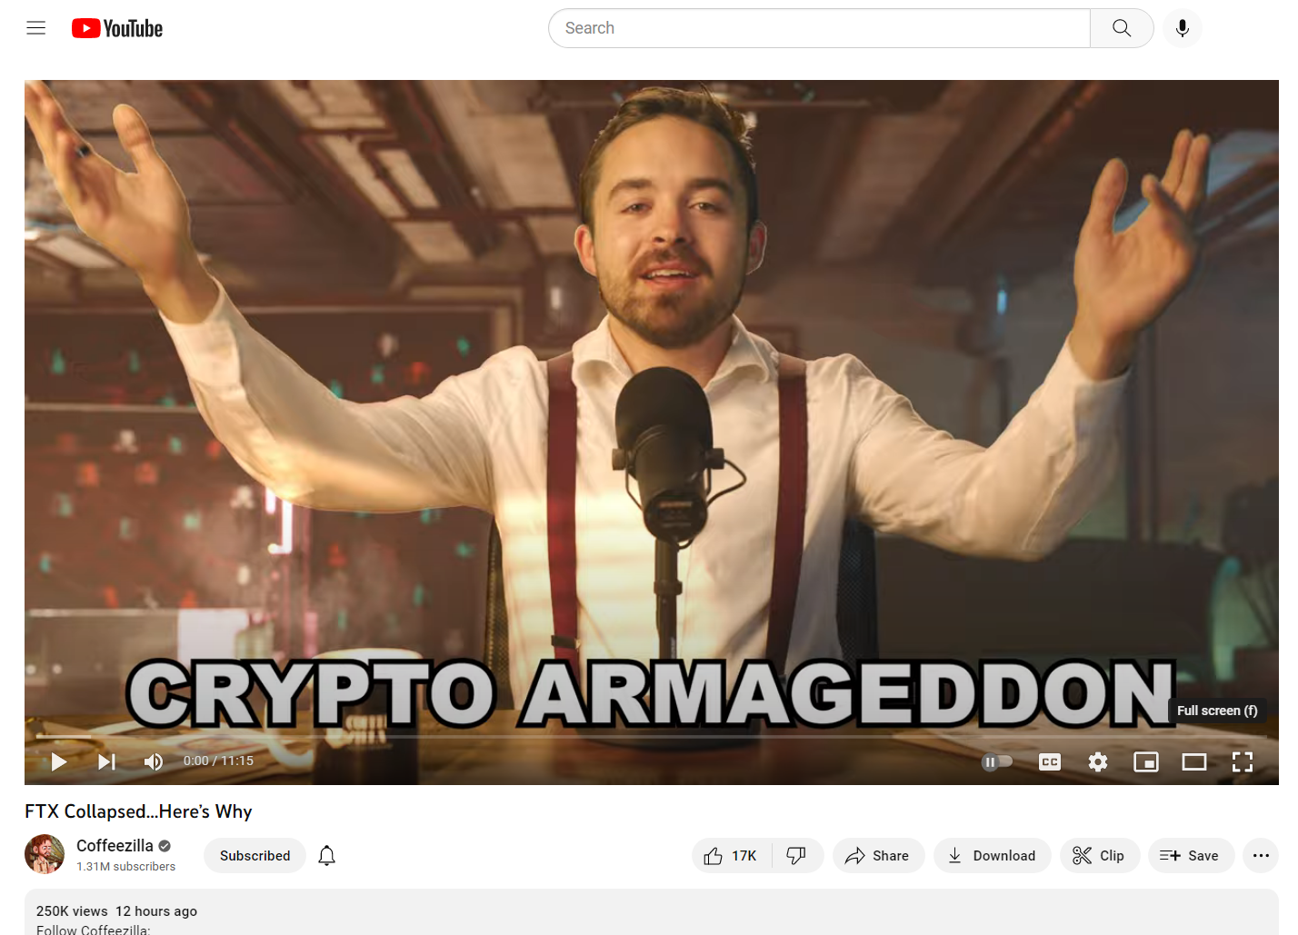
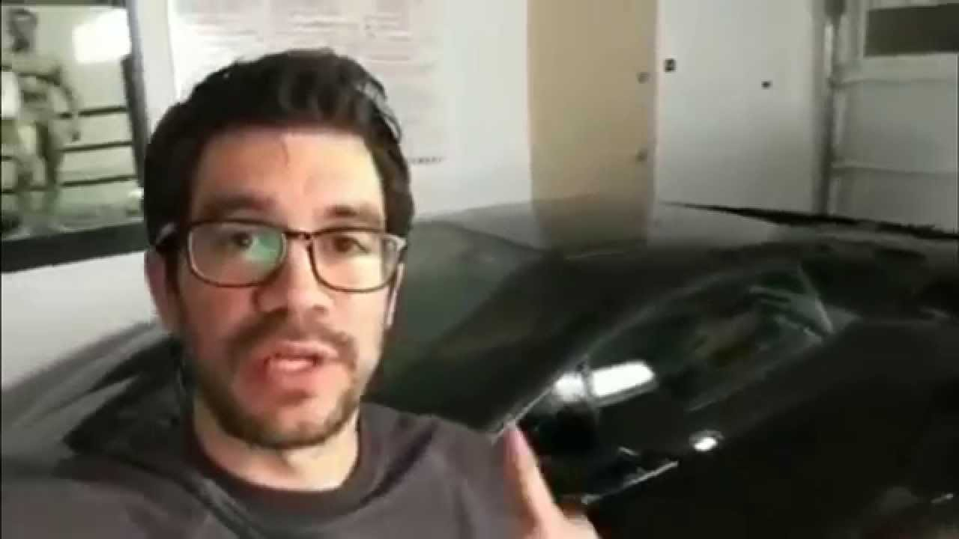
Notes:
Or figure out if the story we’re being told is a lie

Slide 10
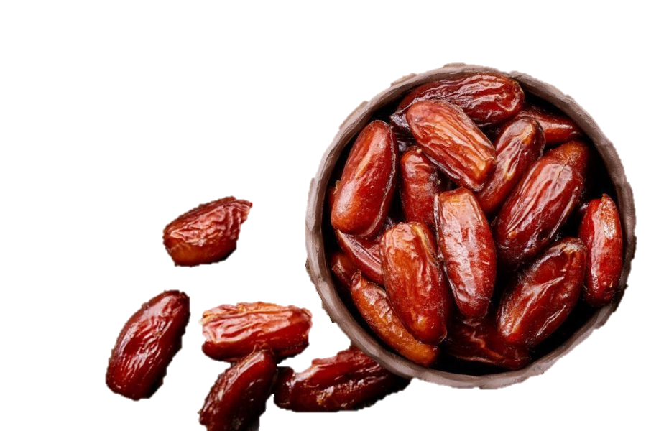
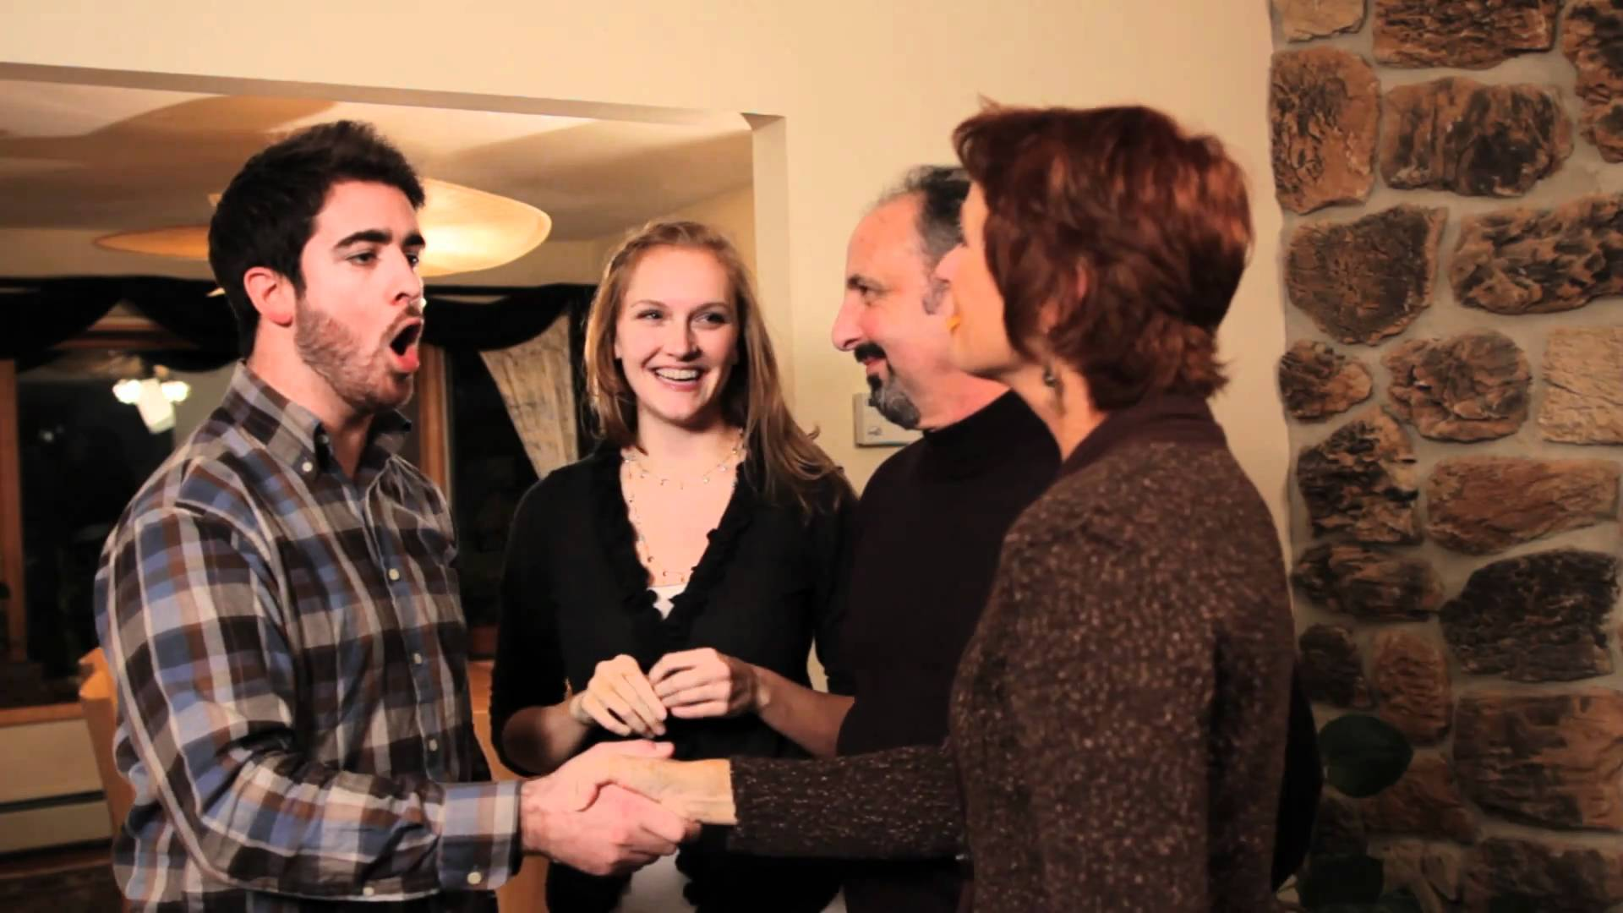
Notes:
Or figure out if the story we’re being told is a lie

Slide 11
Notes:
Or figure out if the story we’re being told is a lie

Slide 12
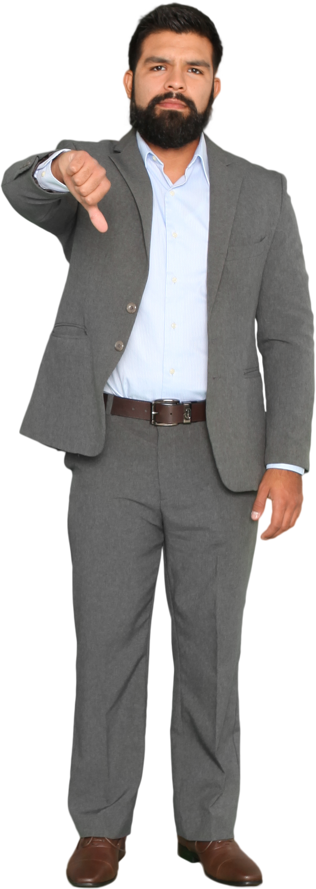
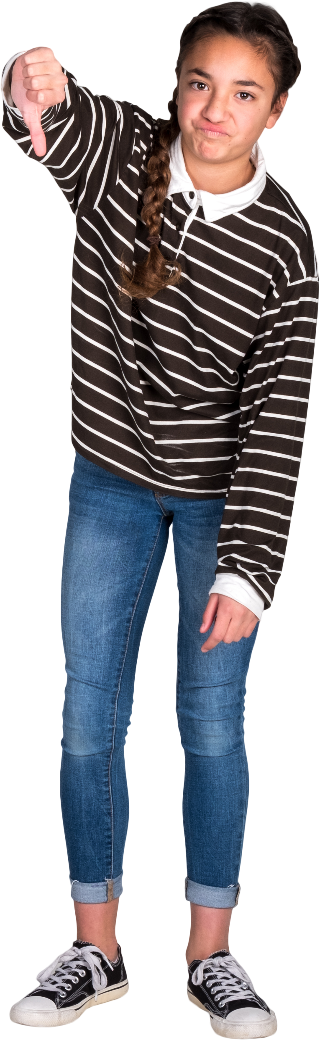

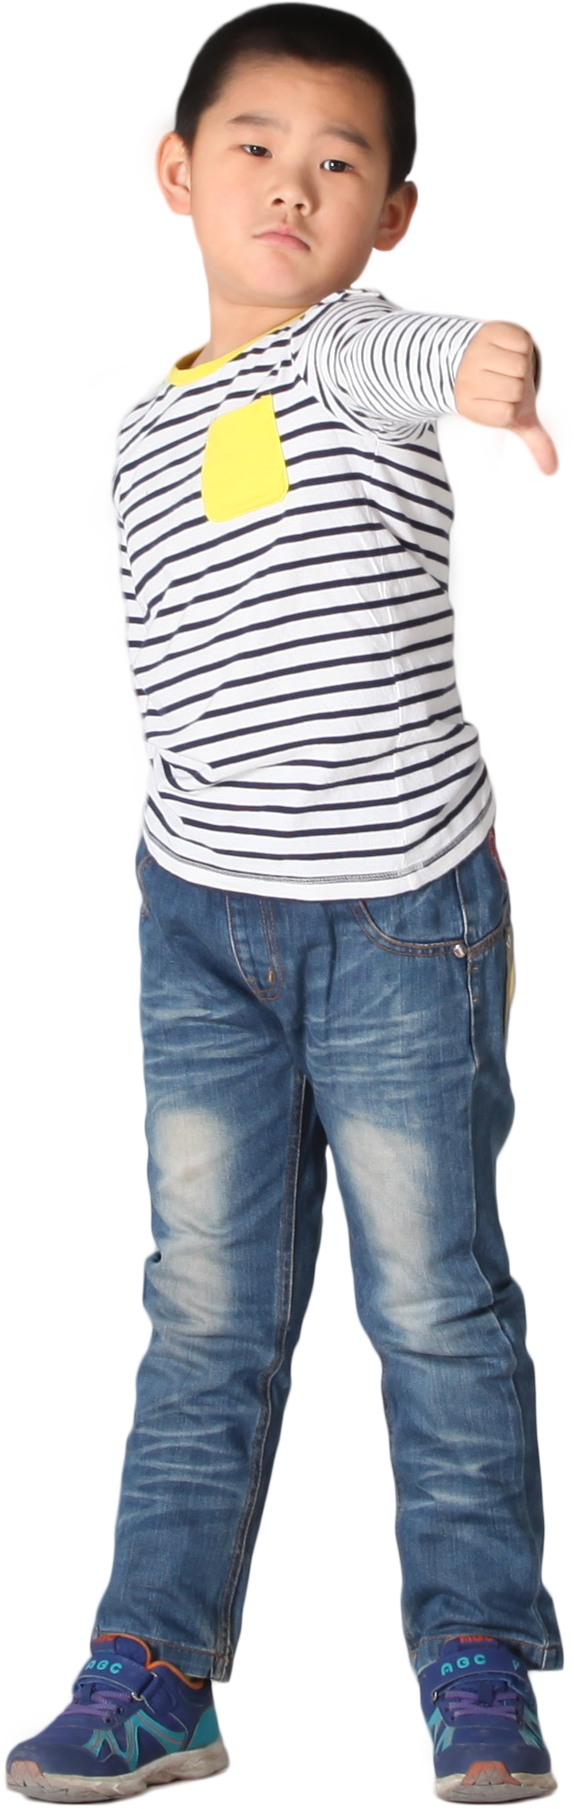
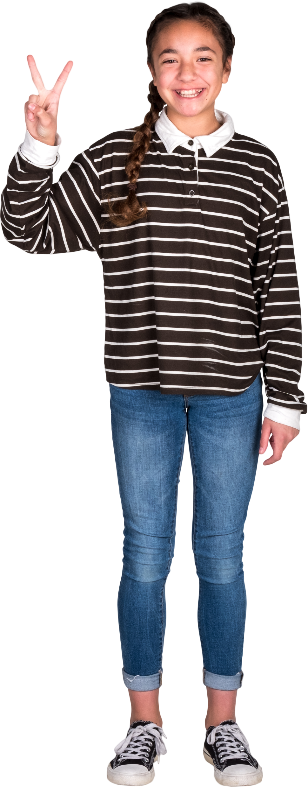
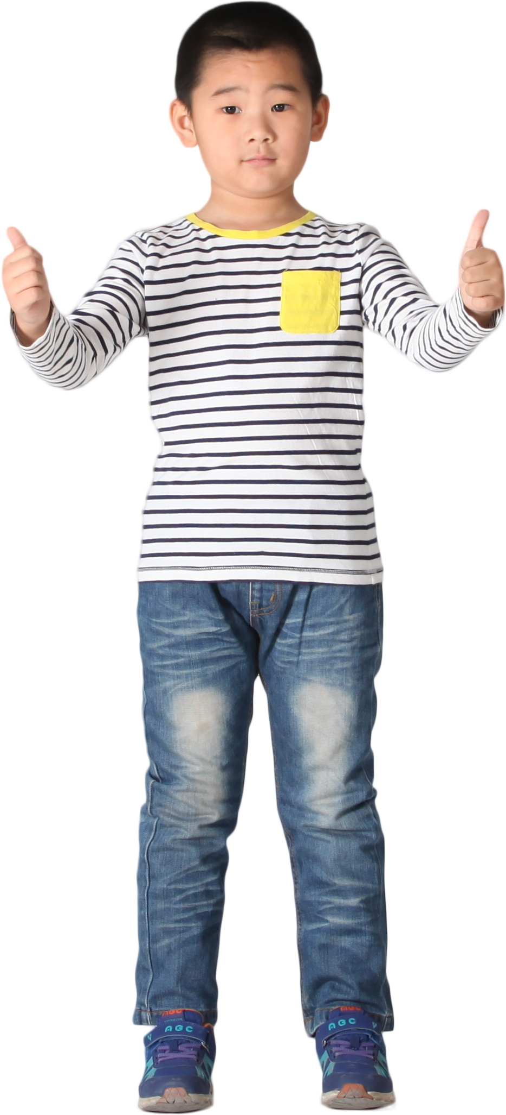

?
?
Notes:
Or figure out if the story we’re being told is a lie

Slide 13
?
Age differences are NOT due to familiarity biases
?
Everyone is equally as likely to engage with novelty
Notes:
Or figure out if the story we’re being told is a lie

Slide 14
?
If the information everyone is seeking is the same, maybe we can find differences in how it is evaluated …
?
Notes:
Or figure out if the story we’re being told is a lie

Slide 15
?
?
e.g., Social Exchange Theory
Notes:
Or figure out if the story we’re being told is a lie

Slide 16
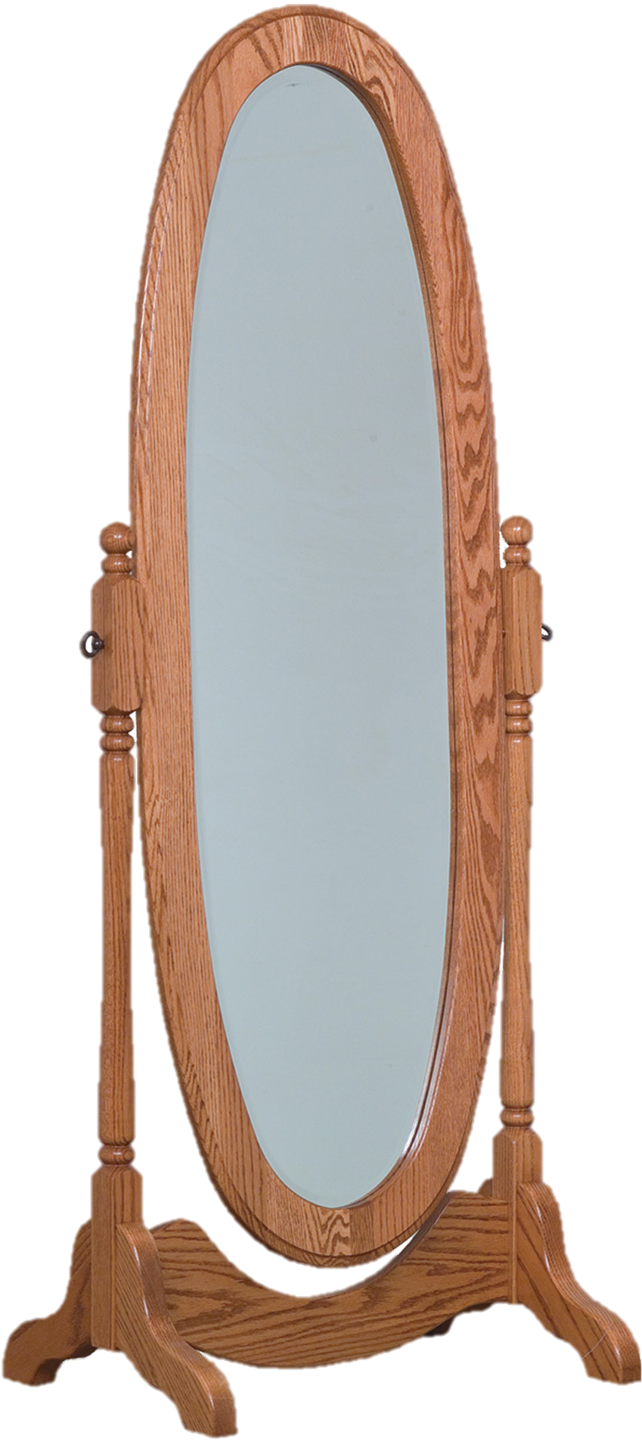
e.g., Social Exchange Theory
Notes:
Or figure out if the story we’re being told is a lie

Slide 17
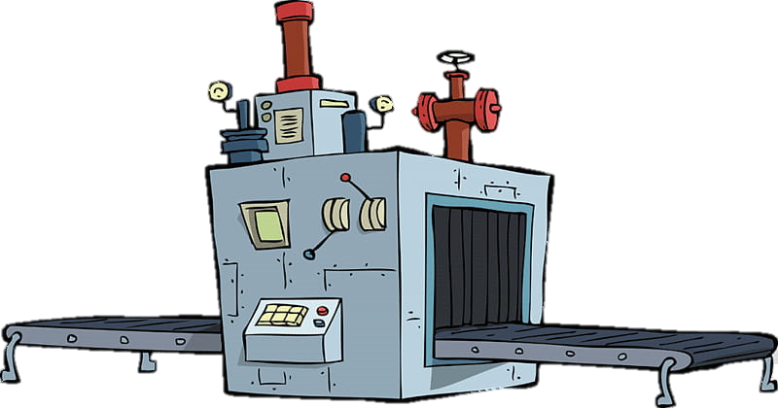


Notes:
Or figure out if the story we’re being told is a lie

Slide 18
?
Notes:
Or figure out if the story we’re being told is a lie

Slide 19
F99 Phase Dissertation Research
Exploring the formation of outcome-based social uncertainty judgements across early normative development

Slide 20



~60 Participants
01 Video
_{Age Range = 08 – 23 yrs}
Season Finale of Master Chef Jr. _{2 Runs} _{Length = ~15 m}

Slide 21
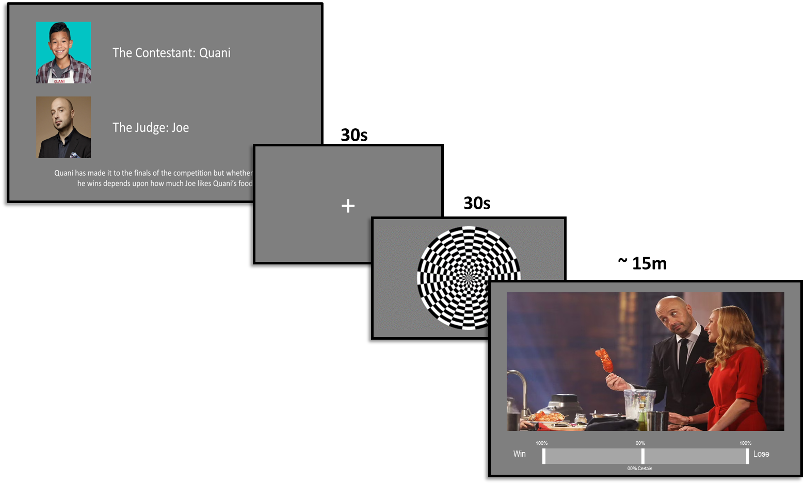
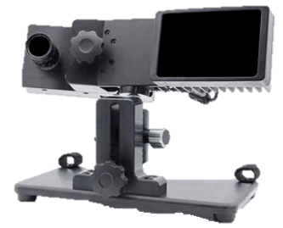
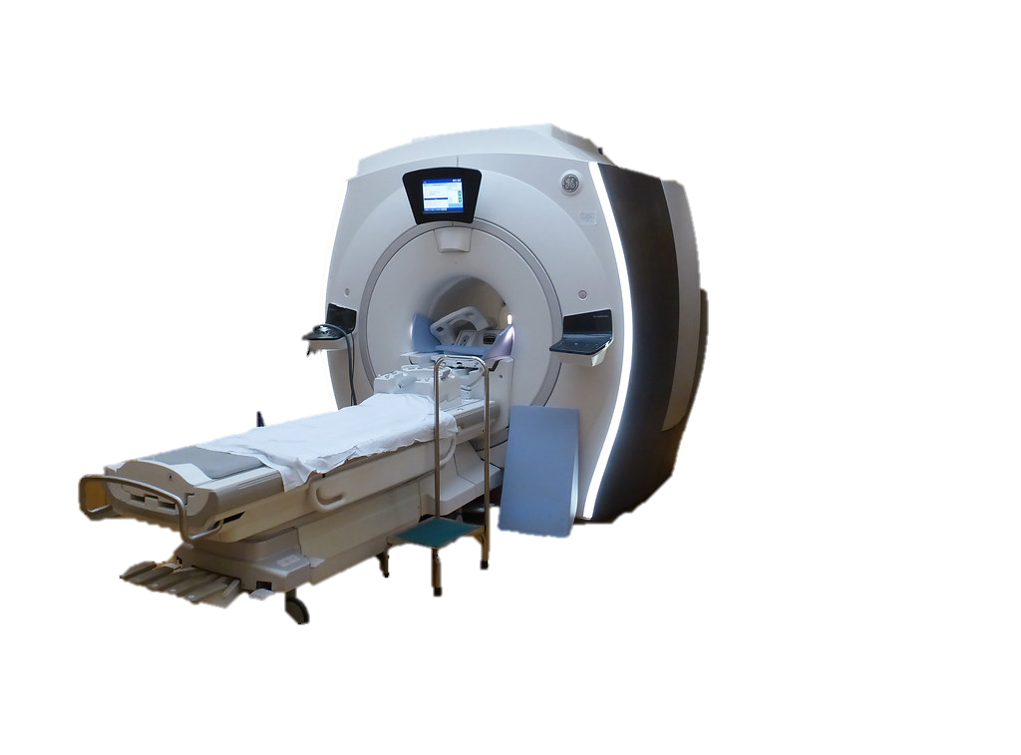
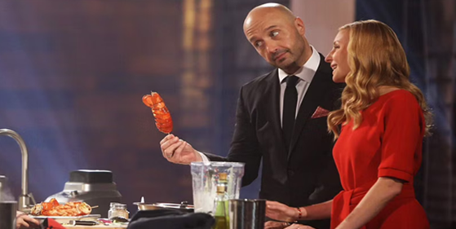


Slide 22
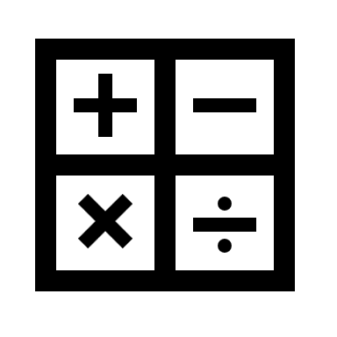
Computational Neuroscience

Slide 23
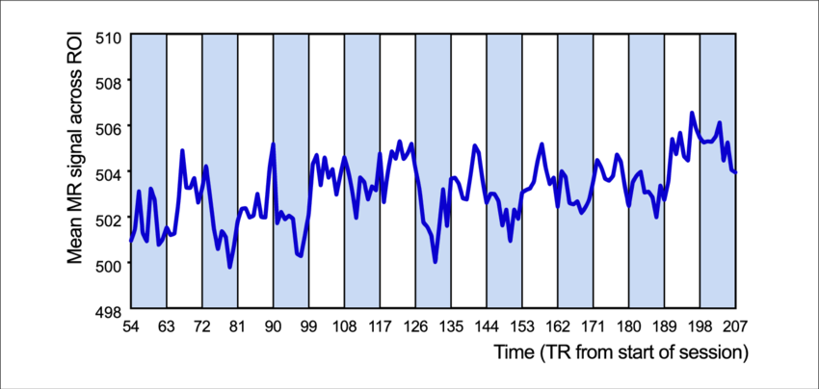
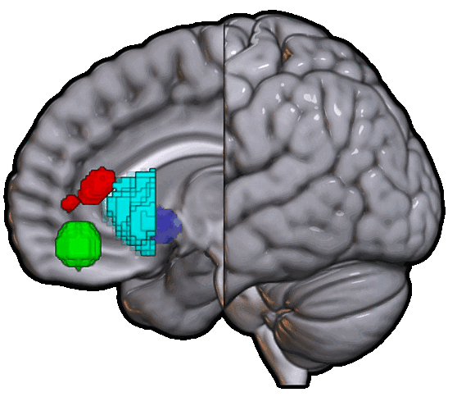
ACC
VS
OFC
AI

Slide 24
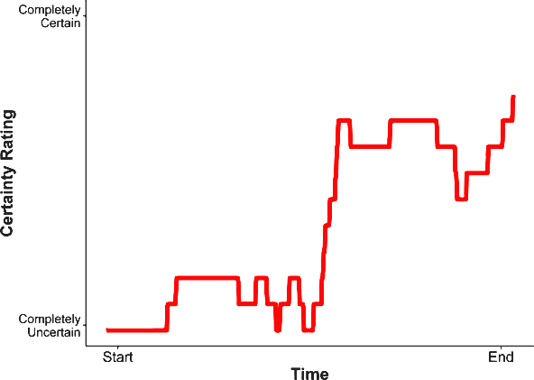
ACC
VS
OFC
AI

Slide 25
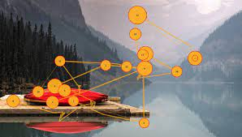
ACC
VS
OFC
AI

Slide 27
EyeLink 1000 Plus

Slide 28


Gaze Points
EyeLink 1000 Plus

Slide 29
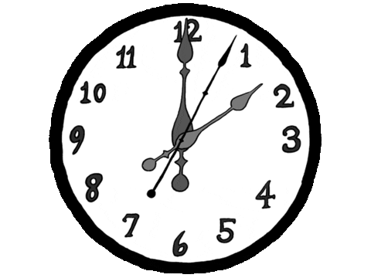
Fixations
EyeLink 1000 Plus

Slide 30

Saccades
EyeLink 1000 Plus

Slide 31
Fixation Sequences
4
EyeLink 1000 Plus
2
7
6
3
8
1
5

Slide 32
ACC
VS
OFC
AI

Slide 33
K00 Phase Post-Doctoral Fellowship
Comparing the efficacy of and mechanisms behind regulatory strategies to manage uncertainty

Slide 34
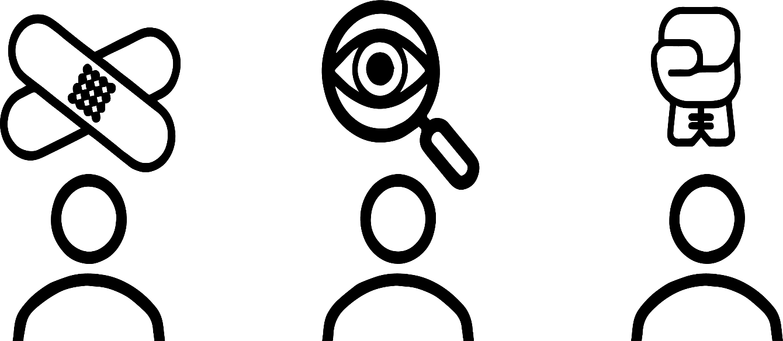
Friend of the Victim
Friend of the Accused
Detective
Notes:
These roles can be an ideally unbiased detective
or friends of either the victims or the accused persons

Slide 35
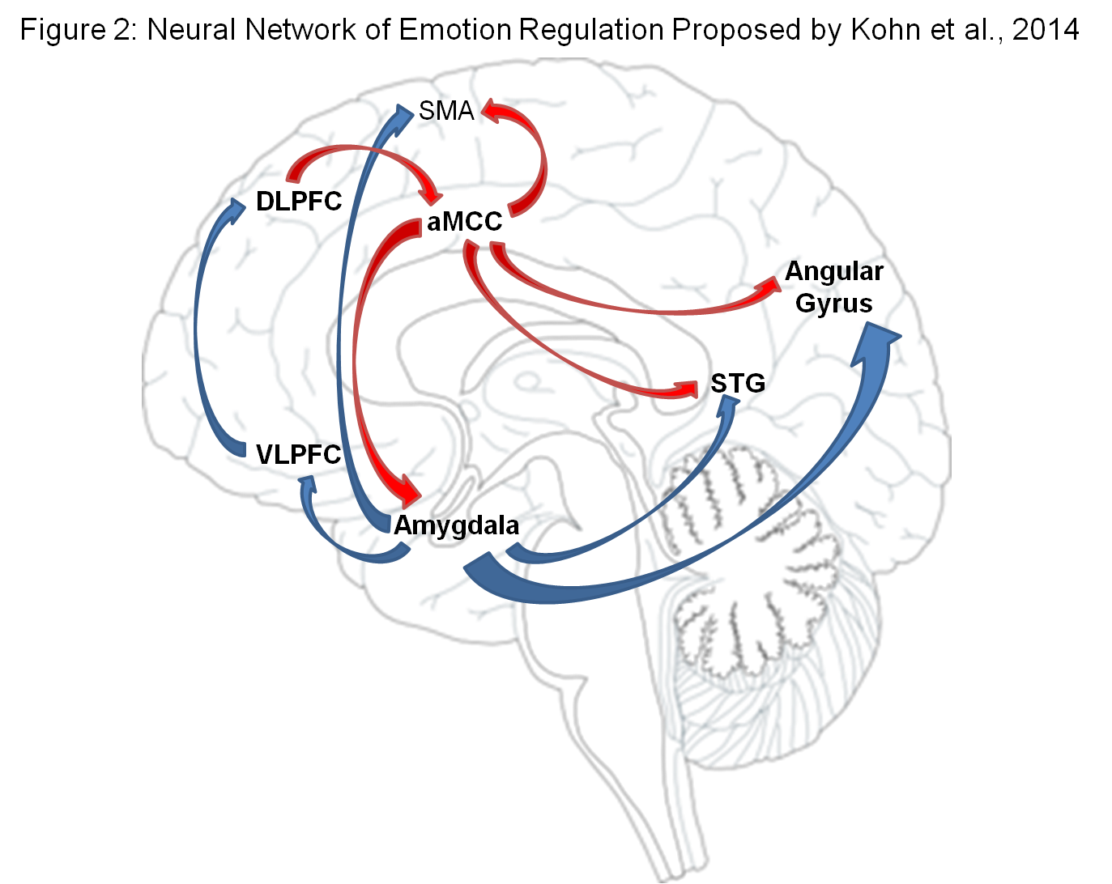
Prefrontal self-regulatory regions undergo significant maturation throughout early development
Notes:
These roles can be an ideally unbiased detective
or friends of either the victims or the accused persons

Slide 36
Prefrontal self-regulatory regions undergo significant maturation throughout early development
As such, dependent regulation strategies such as reappraisal are less effective at earlier ages
Notes:
These roles can be an ideally unbiased detective
or friends of either the victims or the accused persons

Slide 37
Prefrontal self-regulatory regions undergo significant maturation throughout early development
As such, dependent regulation strategies such as reappraisal are less effective at earlier ages
Role-play is effective earlier, engaging, and recruits different neural structures that may be less dependent upon development
Notes:
These roles can be an ideally unbiased detective
or friends of either the victims or the accused persons

Slide 38
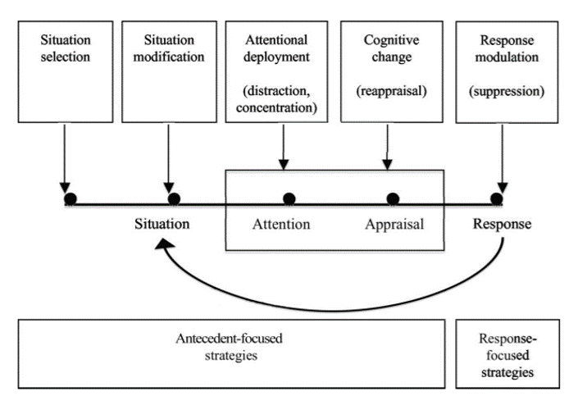
The Process Model is helpful for thinking about how the time of application for a given strategy influences its efficacy

Slide 39


The Process Model is helpful for thinking about how the time of application for a given strategy influences its efficacy
If Role-Play is effective, perhaps it’s because it’s being applied earlier in the time-course and has influence upon cognitions downstream of it (i.e., how we appraise and pay attention to information)

Slide 40
Questions?

Slide 41
